Slide 1
Product sales analysis
Presented by
Sujith d
Darshan J
Kowshick S
Pranesh s
Manikandan m
Jayaseelan

Slide 2
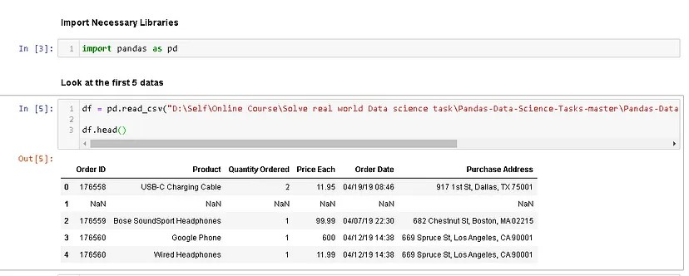

Slide 3
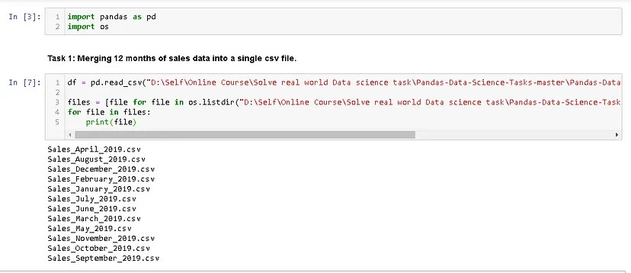
We use panda to read the csv file and create a dataframe from it. The file’s directory can be put anywhere. I personally put it in D. You can copy the directory and paste it in the syntax. At Figure 1, we can see that we have 6 columns. Now the first task is to merge all 12 months worth of sales data (12 csv files) into a single csv file. To do that, we need to import new library called os.

Slide 4
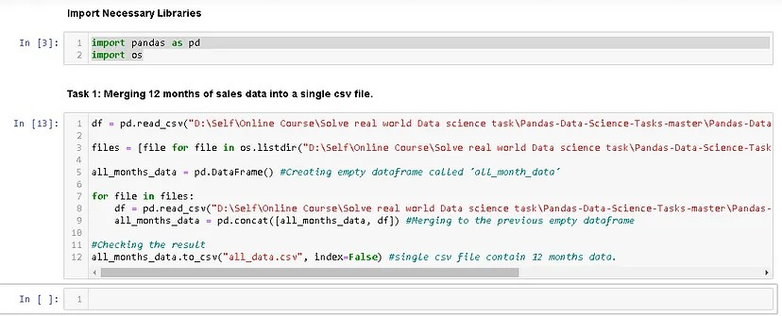
We need os library to read all csv files’ title and call it using for loop. As you can see from Figure 2, we successfully read all the csv files’ title and we’re ready to merge it. To do that, we can simply do

Slide 5
Detail code
Import pandas as pd import os df = pd.read_csv(“D:\Self\Online Course\Solve real world Data science task\Pandas-Data-Science-Tasks-master\Pandas-Data-Science-Tasks-master\SalesAnalysis\Sales_Data\Sales_April_2019.csv”) files = [file for file in os.listdir(“D:\Self\Online Course\Solve real world Data science task\Pandas-Data-Science-Tasks-master\Pandas-Data-Science-Tasks-master\SalesAnalysis\Sales_Data”)] all_months_data = pd.DataFrame() #Creating empty dataframe called ‘all_month_data’

Slide 6
Df = pd.read_csv(“D:\Self\Online Course\Solve real world Data science task\Pandas-Data-Science-Tasks-master\Pandas-Data-Science-Tasks-master\SalesAnalysis\Sales_Data/”+file) all_months_data = pd.concat([all_months_data, df]) #Merging to the previous empty dataframe #Checking the result all_months_data.to_csv(“all_data.csv”, index=False) #single csv file contain 12 months data.

Slide 7
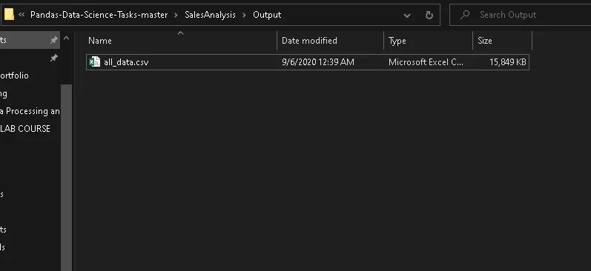
It will take a little longer time because of heavy computation. But once it’s done, you can open the same directory folder and check the folder called “Output”. You will see a new csv file contains all 12 months data.

Slide 8
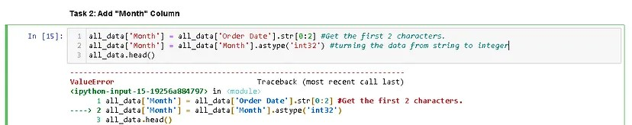
To answer this problem, obviously we need an additional column called “Month”. If you look carefully at Figure 5, you will see the first 2 characters in “Order Date” values represent months. So the next task we will do is to add “Month” Column.

Slide 9
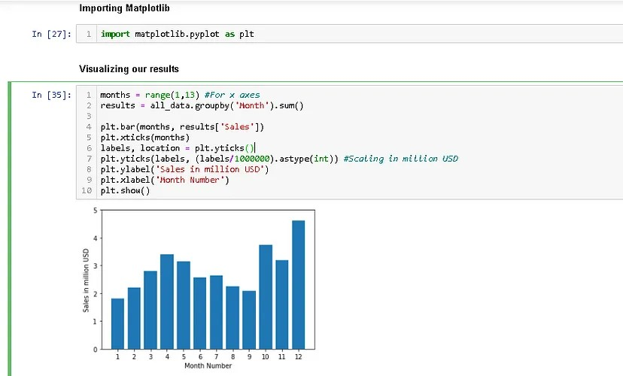

Slide 10
Now, not only we can get the highest sales, but we can also get the lowest sales just by looking it for a few seconds. As a data scientist, we have to figure out why a certain month is better than others. Maybe the company spend more money on April so the product sales are increasing. Maybe the best product sales are on December because it’s holiday and Christmas. Those are just my hyphothesis, right now we don’t have enough data to prove that hypothesis. But we can take these as a consideration if you want to decide something that relates to product sales.

Slide 11
Under the guidance of
Aruna c

